Slide 1
place
date
presenter
Building a future for learning
Digivisio 2030

Slide 2
Finland thrives on its diverse expertise
As the world changes, learning and expertise will take forms that we are not yet able to imagine. But, we still understand that we will need more and more experts in the future.
We can't just stand on the sideline, looking on,
while others show the way -
We’ve got to have the courage to build the future ourselves.

Slide 3
Digivisio is a joint project of Finnish higher education institutions whose aim is to create a future for learning that benefits leaners, higher education institutions, and our society.

Slide 4
The objective is to create, as mutual and stakeholder cooperation
Internationality
LEARNERS’ My Data, DATA POOLS
A national digital service platform
Guidance based on e-learning, the learner’s path and shared data
Support for change management for higher education institutions
CHANGE MGMT
CHANGE MGMT
eStudy services
Continuous learning
DIGITAL PEDAGOGIAL COMPETENCE
ACCESSIBLE EDUCATION OFFERING
LEARNERS’ PATH, DIGITAL STEERING & SUPPORT
Key projects
Ecosystems of learning
and working life
Upper 2ary education
CHANGE MGMT
Notes:
A national digital service platform that
enables the compatibility of digital services between higher education institutions,
provides a “my data” service for the learner and integrates the accumulation of the learner’s competence before and after the higher education in the learning and career path, and
improves the compatibility of the actors' IT services and lowers the threshold for utilizing national solutions.
Guidance based on digital pedagogics, the learner’s path and shared data, which
supports studies and student well-being regardless of time and place and in an accessible way,
introduces AI solutions to aid the guidance, and
places the learner's benefit at the centre of development.
Support for change management for higher education institutions, so that we can
introduce the national digital service platform,
digitize student administration processes and admission to higher education institutions,
support the evolution of higher education institutions into open communities managed by information, and
make data available for individuals and the society.

Slide 5
Digivisio enables learners to learn more easily and flexibly, thus allowing them to accumulate the necessary expertise for a constantly changing world.
Digivisio strengthens the role of the teacher as a producer of high-quality content and as a facilitator of internationally renowned study experiences.
Digivisio ensures that the standard of higher education rises and Finns’ access to employment improves – both in Finland and abroad. One of the goals of Digivision is to build a national digital service platform, Opin.fi, which opens up endless learning opportunities for all stages of work and life. It brings together the offerings of Finnish universities and universities of applied sciences. Opin.fi is open and free of charge for everyone.

Slide 6
A vision shared by all higher education institutions
300,000
38
10
higher education students
Finnish higher education institutions
years
27,000
320
48 M€
higher education institution employees
working on the
project
project budget (12/2023)

Slide 7
The project is founded on equal and open decision-making.

Slide 8
Joint project of all Finnish higher education institutions
General Assembly Senior decision-maker/ Decision-making body
approves the action plan and budget
consists of representatives of higher education institutions
Steering group operative director
strategic management of the project and ensuring stakeholder cooperation
Led by Ilkka Niemi (Aalto University)
Project office practical implementer
planning and implementation of the project's practical activities
Project Director Hanna Nordlund

Slide 9
Digivisio 2030 timeline
2022-2023
The implementation of the services will begin, the higher education institutions will begin their change work and the vision work on e-learning is completed.
2024
The first versions of the services are being piloted. Joint criteria for high quality e-learning is applied in the open offering at higher education institutions.
2025
Education offering for continuous learning at higher education institutions and the learner's own data can be found in one service, which is open to all continuous learners.
2026
The learning ecosystem is starting to form. Digivisio services are widely used by higher education institutions and learners.

Slide 10
Keeping our position globally as the best place to learn will continue to be the guarantor of Finnish competitiveness.
”

Slide 11
Scenario Finland has an internationally esteemed open learning ecosystem that widely benefits society as a whole

Slide 12
Opin.fi - The first implementation of Digivisio

Slide 13
Opin.fi – takes you on your own learning journey
Opin.fi is a completely new digital service that brings together the open study offerings of Finnish higher education institutions in one place. It is a service created for all learners who want to apply or return to higher education.
In the future, each learner will continuously develop themselves, learning new things and updating their old skills. Opin.fi encourages students to familiarise themselves with the most diverse study opportunities and helps them plan their own individual learning journey.
Finnish higher education institutions are currently developing the service, and it is expected to be ready for use by 2025. Join us and create a world of future learning together.

Slide 14
World of expertise 2030
The world is changing at an accelerating pace. People's expectations and ways of acting are changing fast.
The competition for experts is getting tougher. In working life, there is a constant need to adopt new skills. Learning and expertise will take forms that we are not yet able to imagine.
We do know, however, that the future will not be built just by solving today's problems or by looking on while others show the way.

Slide 15
World of learners 2030
The learning ecosystem shifts its focus from the organisation to the learner.
Both experts and education providers develop their expertise.
Studies involve an extensive network of contents and study modules produced by parties outside higher education institutions.

Slide 16
World of learning 2030
The provision of joint learning and building of systems will be made possible through cooperation between higher education institutions.
Learning independent of time and place.
Analytics can provide new information for planning and targeting the offering.

Slide 17
Digivisio is
a delight and benefit for learners, teachers and society

Slide 18
Continuous and flexible learning tray
As a learner, I can...
As a higher education institution, we can...
Provides the student with one user interface that is seamlessly integrated with other national information systems
A brand that strengthens the HEI’s own brands will be created and implemented in accordance with the Digivision scenario
Examine the education offered by higher education institutions for education that does not lead to a degree. The offering consists of formal, non-formal and informal education.
Find education offering that best meets my lifestyle, schedule and competence needs
Select a Finnish higher education institution, whose offering I value highly and trust to be of a good quality, as a partner in continuous learning
Achieve a wider and more diverse learning base regardless of regional boundaries
Improve our operations based on the data collected by the service
Develop a more versatile offering that can respond to the different motivations and interests of continuous learners

Slide 19
Technical capabilities developed
The continuous and flexible learning tray retrieves and presents the educational offering from the data platform, enables comparison and selection, and displays the transaction to the learner.
A user interface that brings the features together in one place and displays the offering
Educational offering
enables the presentation and comparison of the offering
My Data enables a personalized service experience and transparent transactions by tapping into the existing data and supplementing it in the process.
AI-based guidance services form the tray’s recommendation engine to promote the alignment of supply and demand.
Joint enrolment and admission services improve the implementation of conversions: unified process for registration and payment for the learner, attaching oneself to an institution or cross-institutional studies.
Key technical capabilities: identification, personalization, guidance and enrolment
Identity management enables authentication via the learner’s national, user-centric identity.
The joint data platform collects the data required by the continuous and flexible learning tray from source systems and returns updated information to them. Data stored on the platform can also be used by other actors and software.
The joint data platform retrieves data from source information systems, stores transactions, and returns or redirects data for different use cases.
Source systems describe the offering and store the master data

Slide 20
For learners
For teachers and support services
For higher education institutions
Different contents in a manner that is flexible and suitable for the learner
Access to learning-related information for life and services based on one’s own profile
Search and recommendation functions help to identify competence needs and guide students towards suitable studies and also their next steps
Learning both in everyday life and as broader entities
Beginning studies is easy and encouraging
Guidance and support in a manner that suits one's needs and capabilities and is automated when appropriate
Less manual work, more time for guidance and encounters
Emphasis on creating learning content and learning experiences in their work
Team-based approach and strengthening cooperation in the planning and implementation of studies
Common operating models and quality criteria to support work also across the boundaries of higher education institutions
Methods and technologies of interaction are developed and researched, the best practices will be scaled
Developing pedagogical competence is an encouraging part of their work
Broader and more versatile set of learners, unrestricted by regional boundaries. Provision of advice and guidance.
Making operations more efficient using data collected by the service, increasing data capabilities
Increased amount of cooperation between higher education institutions, common rules and operating models
Being profiled on the tray based on their own strengths
National digital services save resources, not everything needs to be done alone

Slide 21
High quality pedagogy
has a key role in
Digivisio 2030

Slide 22
The world's best higher education pedagogy
Evolves with time
pedagogy relevant to learners and the world of work evolves as the world changes
E-learning is an integral part of pedagogy
instead of a static operating model, the change aims for flexibility and adaptability
Builds on everyday life
a change is underway and higher education institutions are already doing something at their own pace – they will be encouraged to continue like this in the future
teachers’ success is central to both learners and higher education institutions
learners and teachers need more extensive support in their everyday lives
Meets the needs of different learners
enables a study-driven lifestyle
removes obstacles from the learning path
information sharing between higher education institutions and their cooperation creates world-class offerings
Develops in interaction within the higher education community
it is in the learner’s interest that higher education institutions and teaching staff work in close cooperation, share information and coach each other
the world's best pedagogy develops when pedagogical experts meet each other

Slide 23
Programme to
support higher education institutions in successfully identifying and facilitating changes brought about by Digivisio in their communities

Slide 24
Programme to support change management
Identifying the change impacts of the project → higher education institutions make their own change management plan based on their own strategy and decisions (deadline on December 2022)
Supporting in deploying solutions → higher education institutions get the most out of the project
Providing support for networking → networking and cooperation of higher education institutions
Producing information on the impact and outcome
Notes:
This programme will support higher education institutions in successfully identifying and facilitating potential changes brought about by Digivisio in their communities

Slide 25
Objectives in piloting
Experimenting with different plans, processes and functionality of solutions.
The aim is to reduce uncertainty
before the implementation of plans, processes or solutions
before wider adoption of solutions.
Ensuring the desired change or impact achievement.

Slide 26
Piloting with higher education institutions
The project will produce a number of technical releases.
Co-creation with end-users and higher education institutions is key in the design and implementation of the technical releases. One form of co-creation is piloting.
Higher education institutions can apply to become a pilot institution.

Slide 27
International collaboration
International students/ learners can take advantage of the learning ecosystem
Technical solutions will be based on open APIs and interoperability is considered in the development
Several HEIs in Finland are part of European University Alliances and proceeding of these initiatives and the solutions developed in those initiatives are being examined
Interest in European collaboration

Slide 28
ROADMAP 2021–2026
The beta version of Opin.fi has been opened to learners to a limited extent for feedback. First production versions have been launched, and continuous services operate at the service level defined by higher education institutions
Opin.fi service and first higher education institutions are ready for launch
Release components 2.0 and 3.0 of the Opin.fi service
Implementation of identity management in production use
Themes for the next phase of the project have been specified and further funding has been secured
Micro-credentials included in the piloting of 3.0
Digivisio legal person is in operational readiness
Cooperation and tasks between the company and the consortium have been agreed
Participation in the Virta survey
Close participation of learners
Target architecture described and conceptual model drafted
Implementation of Digivisio 2030 services launched and key integrations defined
Identity management MVP prototype completed
Policies and decisions related to continuous services have been made
Service deployment model defined
Ecosystem model described
Digital pedagogy cooperation: vision for the future of digital pedagogy 2030 defined, closer cooperation between developer networks, training launched, rules for joint offering defined
Promoting the need to amend legislation and common interpretations
Change management programme launched
Select elements of key project work have been included in the project
Consortium working and decision-making model established
Stakeholder forum activities established
Quality management integrated in all project activities
Tools required for project work in use
2024
2022
2025
2021
2023
2025 – To be specified as part of the clarification of the target scenario
Study offering and learner information in one place
Seamless processes and services have been implemented
Significant added value for learners and higher education institutions through the data in the Opin.fi service
Gradual inclusion of degree studies in the Opin.fi offering
Learner's user path described
Target architecture described
Needs for legislative changes identified
Current projects and systems analysed
Functional specifications of the Digivisio 2030 services completed
First two limited Digivisio 2030 deployments decided
Necessary measures have been outlined based on the legal persons' report
Higher education institutions and the Ministry of Education and Culture are committed to a shared vision
Financing, project and resourcing planned
Development and management model attached
The first production versions of the Digivisio 2030 services launched, and continuous services operate at the service level defined by higher education institutions
Minimum implementation of identity management piloted in pilot higher education institutions (2023)
Release component 1.0 of the Opin.fi service (2023) and rules
The Opin.fi service contains modules produced jointly by higher education institutions
Policies on the functions of course offering and applying for education in relation with higher education institutions’ systems have been created
Digital pedagogy rules for joint learning used in the joint offering of higher education institutions
Utilising modularity in course offering appropriately, supporting the learner’s study path.
The change management programme provides support for the deployment of Digivisio 2030 services and the change work of higher education institutions and offers support to higher education institutions through peer networking
Policies related to learning platform cooperation have been drafted
The plan for future project funding and for the funding of continuous services is ready
Organisation of the consortium in the long term has been solved with legal person

Slide 29
We must have the courage to build the future ourselves.
”

Slide 30
Thank you!

Slide 31
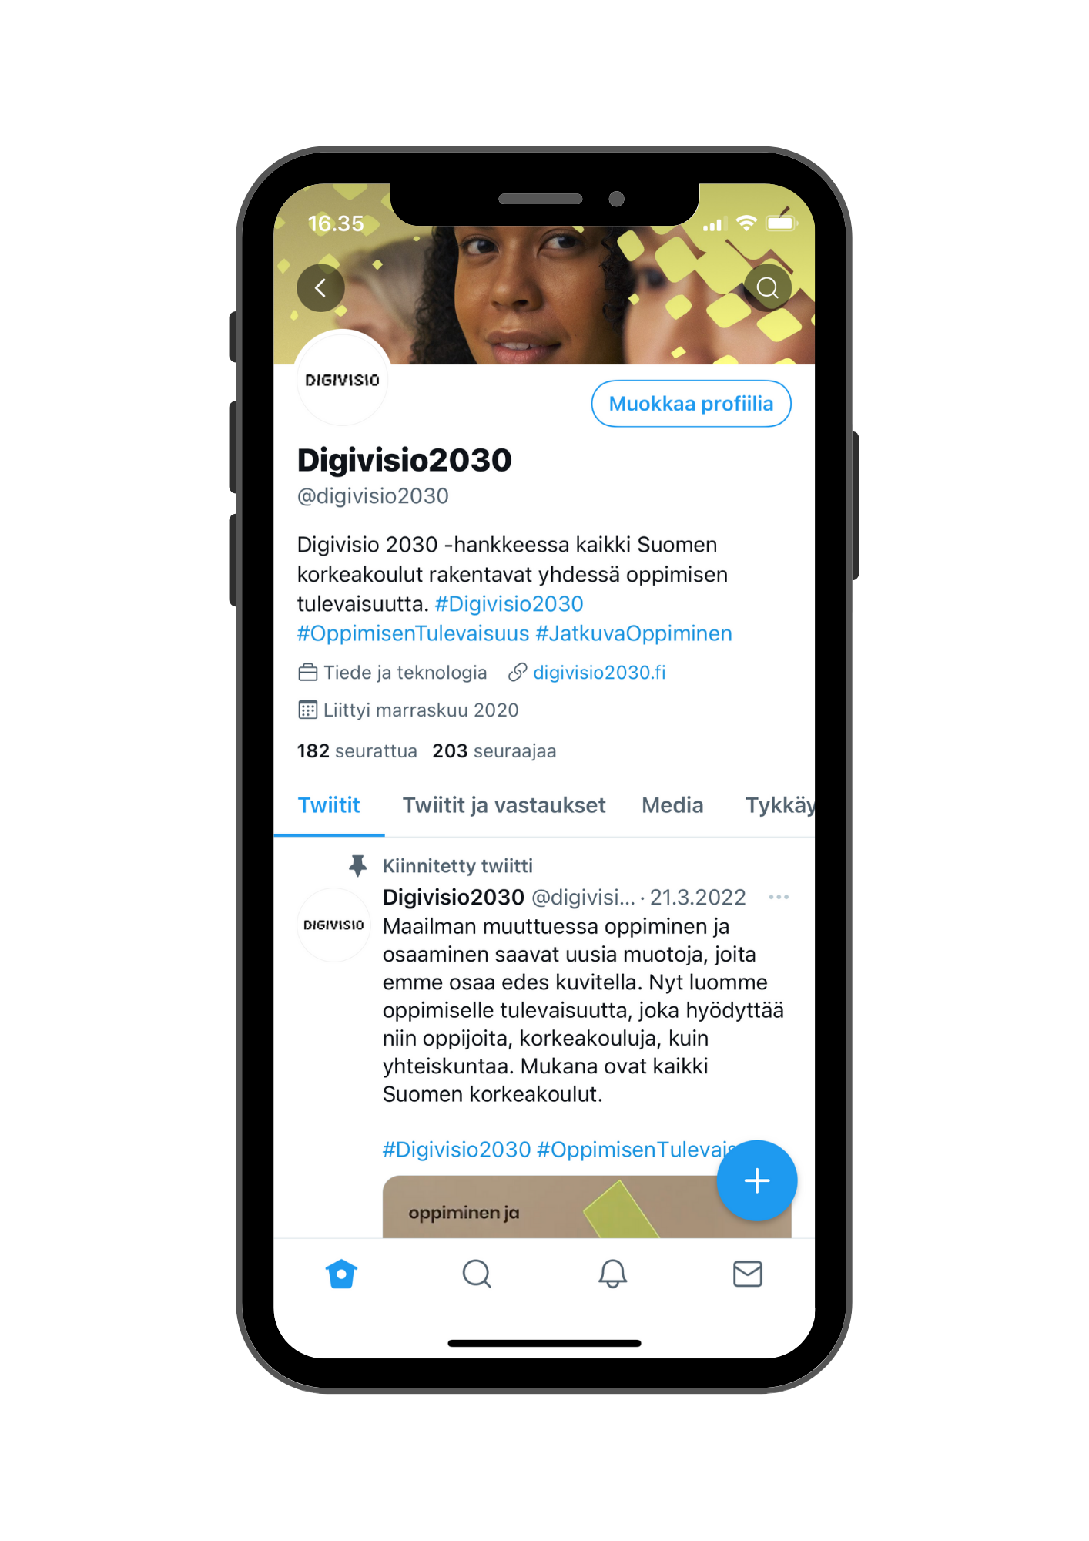
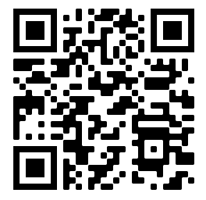
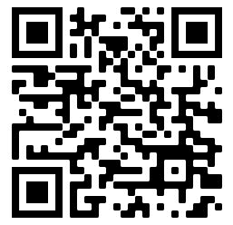
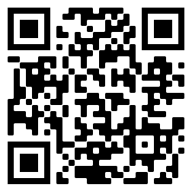
Digivisio newsletter:
Sign up for the Digivisio 2030 project’s newsletters to receive the latest news about the project’s progress directly to your e-mail!
X: @Digivisio2030
LinkedIn: Digivisio 2030
www.digivisio2030.fi
digivisio@csc.fi

